Slide 1
TOP TEN MISTAKES
Presented by: Melinda Garvin, EA

Slide 2
NAEA Survey Article:
1. Failing to Report Payment Received for Work Performed as Independent Contractor
2. Improper Management of Form 1099-B and/or Schedule K-1
3. Filing Early Without Having All Necessary Financial Documents

Slide 3
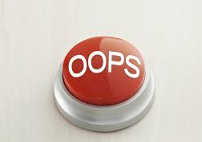
Nerd Wallet Article
MAKING MATH ERRORS
FAILING TO REPORT SOME INCOME
CLAIMING TOO MANY CHARITABLE DONATIONS
REPORTING TOO MANY LOSSES ON A SCHEDULE C
DEDUCTING TOO MANY WORK EXPENSES
CLAIMING A HOME OFFICE DEDUCTION
USING NICE, NEAT, ROUND NUMBERS

Slide 4
WHO GETS AUDITED?
PEOPLE IN HIGHER TAX BRACKETS
PEOPLE WHO REPORT NO INCOME AT ALL

Slide 5
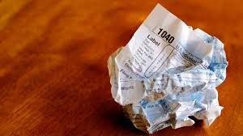
Check out this zingers from Stacy Johnson...
Mistake No. 1: Paying for tax preparation when you can get it free
Mistake No. 2: Getting your Social Security numbers wrong
Mistake No. 3: Spelling your name wrong
Mistake No. 4: Making math errors
Mistake No. 5: Forgetting your John Hancock
Mistake No. 6: Using the wrong tax form
Mistake No. 7: Selecting the wrong filing status
Mistake No. 8: Missing valuable deductions or credits
Mistake No. 9: Failing to claim all your income
Mistake No. 10: Sending your return through the mail

