Slide 1
IS YOUR OFFICE IRS AUDIT PROOF?
Presented by: Melinda Garvin, EA

Slide 4
Analyze, Identify and Overhaul Your Office Procedures
Take a Fresh Look!
Use ‘Tools’
Do It Now!
Set up a Plan
Circular 230 requires it – get in compliance

Slide 5
Circular 230 Sec. 10.33
Best practice rules should be taken very seriously. Failure to comply with best practice rules almost always is an indicator to the IRS as a failure to comply with some other provision of Cir 230.

Slide 6
Safeguarding Taxpayer Information
Publication 4600 – Safeguarding Taxpayer Information – Quick Reference Guide for Business
Safeguarding taxpayer data is a top priority for the IRS
Gramm-Leach Bliley Act (GLB Act) and the Federal Trade Commission (FTC) Financial Privacy and Safeguards Rules

Slide 7
Safeguarding Taxpayer Information (cont)
Pub 4557, Safeguarding Taxpayer Data – A Guide for Your Business
Checklists and incident reporting action tips
www.business.ftc.gov: Copier Data Security: A Guide for Businesses
Protecting Sensitive Information: Your Legal Responsibility

Slide 8
Publication 5293 data security resource guide for tax professionals
Office Security
Required to have
Legal Responsibility
Pub 4557
Gramm-Leach Bliley Act
Federal Trade Commission
Financial Privacy and Safeguards Rules
Pub 1345
Small Business Information Security: The Fundamentals – NISTIR 7621

Slide 9
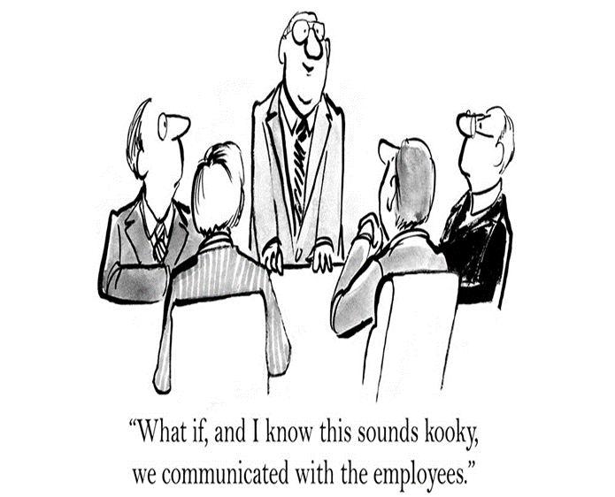
Clearly communicate with clients and IRs
How do we communicate clearly with clients?
Form 8867, Part V, question 14, requires documentation
Organizers
Client Worksheets
Other Tools

Slide 10
How do you coach….teach…instruct…advise…guide…your clients regarding:
Cell phone deduction/percentage of business use
Automobile expenses/business use/documentation
Employee vs. Contractor
EIC/CTC/AOTC/HOH qualifications
Schedule C Hobby or Business
K-1 Losses – Any Basis?
Procedures for Firing Clients – What constitutes that ‘line in the sand’ to cross before they qualify?

Slide 11
OFFICE PROCEDURES
Employee handbook
8879s – signatures and storage
8867s – signatures and storage
8888 – misuse of this form
Consent forms
Conflict of Interest forms – including conflicts of interest with yourself!
Form 2848 – POAs
Written Security Plans
Staff Training Files
Tax Preparer CPEs & Training Files

Slide 12
LET’S LOOK AT YOUR OFFICE

Slide 13
YOUR NETWORK
Buildings next door
printers
Gaming systems
Vending machines
Heating systems
Postage meters
Microwaves
Vacuums
Refrigerators
Water dispensers
Coffee makers
Headphones
Vehicles in your parking lot
Bluetooth
Wi-fi
Elevators
Copiers
Stereos
Tablets
calculators

Slide 14
Cyber Security Best Practice Security Toolbox
Facility Security
Network Security
Email/Website/Wireless Security
Policies of staff education of security
Describe how your firm protects clients' data
Designates Security Coordinator
Develop Policies
Written Information Security Plan
Security Coordinator practices strong security measures
Train Employees
Issue WISP to Employees and get Signatures
Heed security warnings & install patches

Slide 15
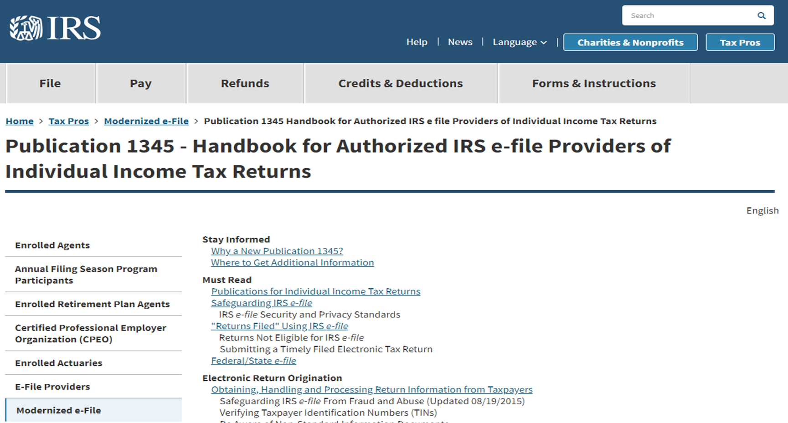
https://www.irs.gov/e-file-providers/publication-1345-handbook-for-authorized-irs-e-file-providers-of-individual-income-tax-returns

Slide 16
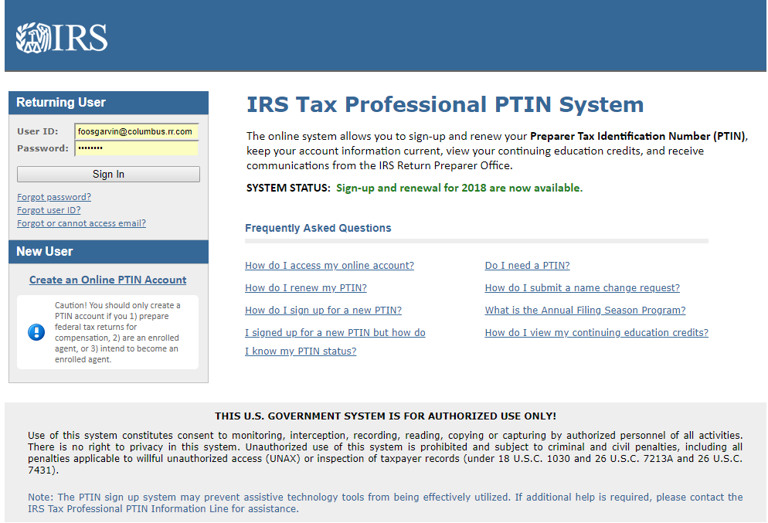
https://rpr.irs.gov/datamart/mainMenuUSIRS.do

Slide 17
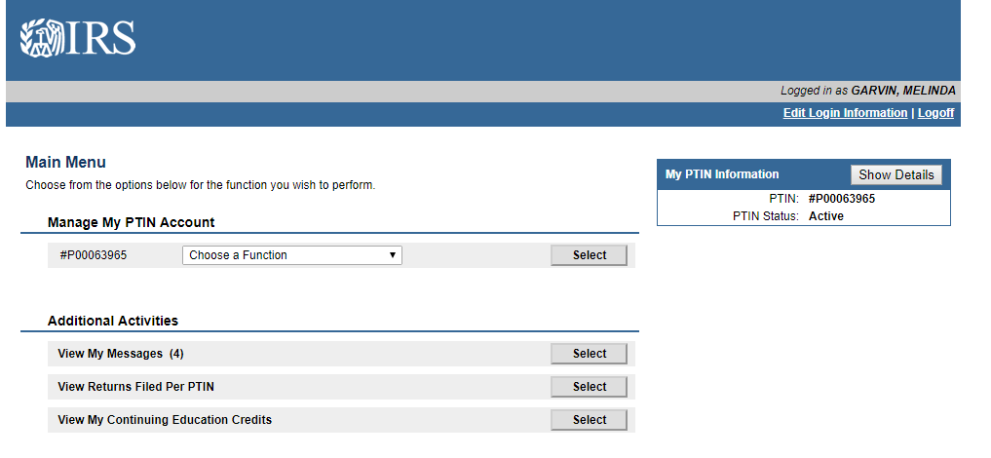
CHOOSE VIEW RETURNS FILED PER PTIN

Slide 18
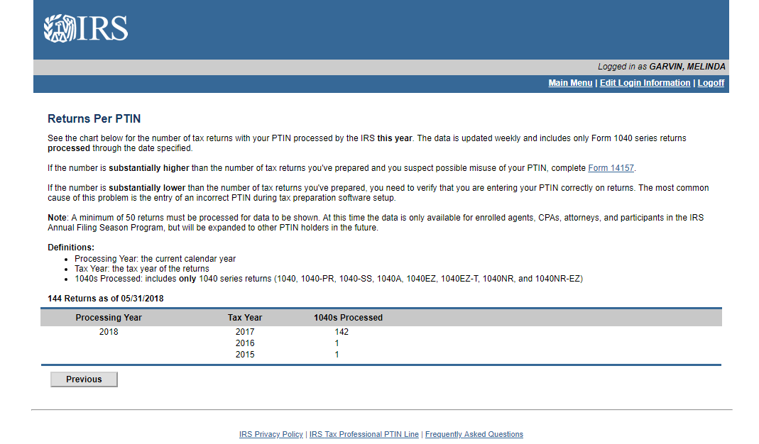
https://rpr.irs.gov/datamart/previouslyFiledReturns.do

Slide 19
Strengths weaknesses
Consider your office
Be Honest
Training
Know what you don’t know

Slide 20
So, you need to decide a couple of things – but let’s wait till the end of the session to let you know what you have to decide and what your answers will be. (remember this question from the beginning of the session?)
Is your office compliant with Cir 230?
Do you need to make changes?
If so, are you willing to make the changes? Or do you think you can continue to keep on doing business as usual?
Over 230 tax offices had to contact the irs last tax season to advise them of a data security breach – I bet some of them were just doing business as usual!

