Slide 1
SCHEDULE K-1 AND BASIS OF S CORP SHAREHOLDER
PRESENTED BY:
MELINDA GARVIN, EA

Slide 2
B – A – P
Basis
At-Risk
Passive Activity

Slide 3
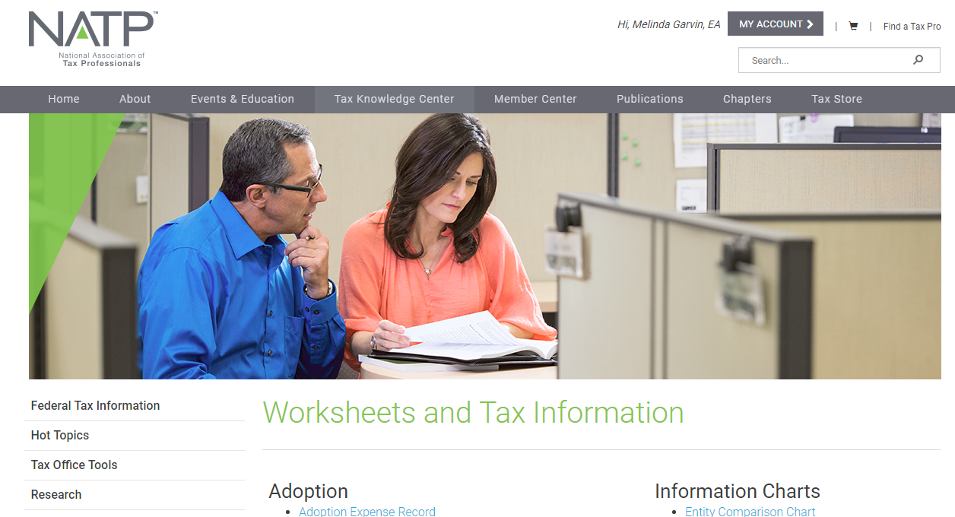
WWW.NATPTAX.COM

Slide 4
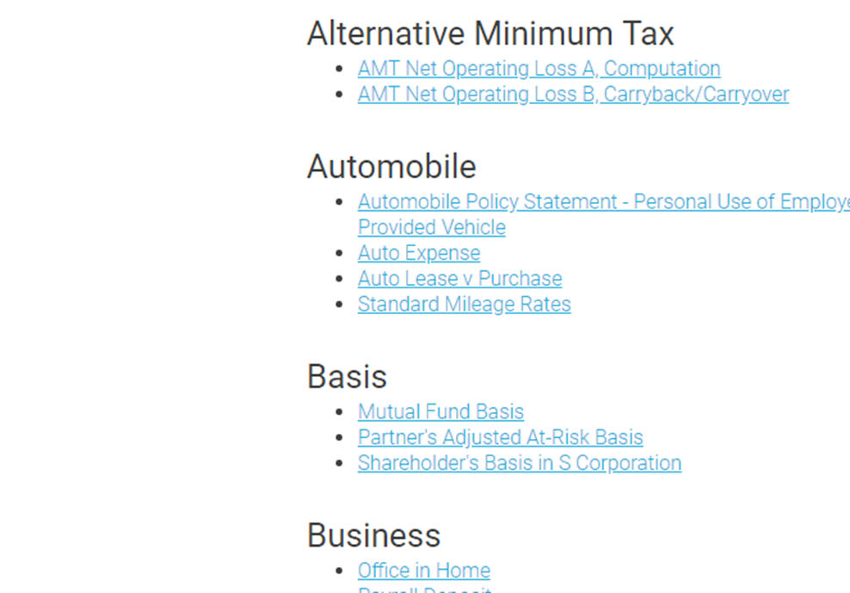
Federal Tax Information/Worksheets & Tax Information Tabs

Slide 6
What’s the big deal?
Losses
Distributions
Sale of business
Death of a shareholder
Whose job is it to track basis anyway?
Each shareholder of an S corporation is responsible for keeping track of basis
Basis must be calculated at the end of the S corporation’s tax year
Every year thereafter
Tracked on worksheets
Software worksheet
NATP worksheet
K-1 instructions worksheet

Slide 7
Initial Stock Basis
Purchase: cost of the shares.
C electing S: basis in C stock at any time of the conversion.
Gift: generally the donor's basis.
Exchange for services: Basis is measured by the stock's FMV, rather than by the value of the services.
Inheritance: generally its FMV at the date of death or, if elected, the alternate valuation date.
When S Corp is capitalized: equal to the basis of the property transferred, reduced by property received and increased by gain recognized on transfer.

Slide 8
Stock Basis Adjustments
Increases
Decreases
All income items of the S Corp
Non-separately stated income of the S Corp
Excess depletion deduction
Cancellation of debt income
Additional capital contributions
Distributions not includible in SH income
The SH's share of the S Corp's separately and non-separately stated loss, items of loss and deductions
The SH's share of non-includable expense
Never below zero

Slide 9
Ordering Rule and Election
Annually on the Last Day
Election
Increased for income items and excess depletion
Decreased for distributions
Decreased for nondeductible, noncapital expenses and depletion
Decreased for items of loss and deduction
There is an election to reduce basis by items of loss or deduction before nondeductible, noncapital expenses.
Made by attaching a statement to the return.
Must be timely filed original or amended return.
Once made, election is used for future years.

Slide 10
DISTRIBUTIONS
Distributions reduce stock basis
Not taxable if enough stock basis before losses or deductions
If distributions exceed stock basis, capital gain is reported on Schedule D

Slide 11
Debt Basis
Must be ‘bonafide’ loans
Provisions are not the same as for Partnerships
Not reduced by distributions
Loan repayments to reduced debt basis create taxable gain

Slide 12
At-Risk Passive Schedule K-1
2nd loss limitation
At-Risk – Form 6198, At-Risk Limitations
3rd loss limitation
Passive Activity Rules
Form 8582, Passive Activity Loss Limitations

Slide 13
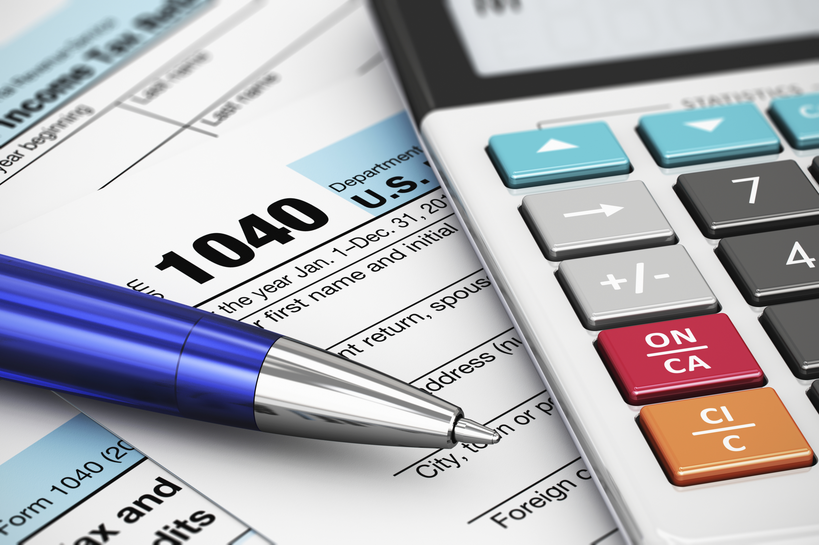
Most common forms needed:
Schedule A, Itemized Deductions.
Schedule B, Interest and Ordinary Dividends.
Schedule D, Capital Gains and Losses.
Schedule E, Supplemental Income and Loss.
Form 1040, U.S. Individual Income Tax Return.
Form 4562, Depreciation and Amortization.
Form 4797, Sale of Business Property.
Form 6198, At-Risk Limitations.
Form 6251, Alternative Minimum Tax Individuals.
Form 8582, Passive Activity Loss Limitations.

Slide 14
Schedule E, page 2

Slide 15
Simple One
The sole shareholder of an S Corp has stock basis of $500. His K-1 increases for the year were $2,000 and interest income $100. Distributions were $800. What is his basis at the end of the year?

Slide 16
Now, with Debt Basis
A shareholder has a beginning basis in his stock of $1,000 and debt basis of $500. His K-1 shows: ordinary loss of $1,200 and interest income of $50. What is the ending debt basis?
His loss on Schedule K-1 will be allowed to flow onto the Schedule E, Pg 2 in full with no suspended carry overs.

Slide 17
Loan, Losses and Distributions
The sole shareholder of an S Corp has stock basis of $7,500 and unreduced loan basis of $5,000. During the year, cash of $8,500 and a computer within FMV of $500 was distributed to the shareholder. Her K-1 decreases for the year were $1,000. What is this shareholder’s stock and loan basis at the end of the year?
The $1,500 of distribution that exceeds basis will flow to Sch D. The $1,000 net loss will be allowed to flow to page 2 of the Sch E.

Slide 18
Basis Question
An S Corp passed through a loss of $1,500 to its sole shareholder. The shareholder also received a distribution of $5,000 during the year. The stock basis as of the beginning of the year was $2,500 and his loan basis was $5,000. What are the balances of Stock and Loan Basis at the end of the year?
Stock Basis Debt Basis
Beginning Basis $2,500 $5,000
Distribution $ (2,500) XXXX
Subtotal $ -0- $5,000
Ordinary Loss _-0-_ $ (1,500)
Ending Basis $ -0- $ 3,500

Slide 19
Basis Question
After you determine Stock and Loan Basis – what are the entries from the K-1 that flow to the Form 1040?
Stock Basis Debt Basis
Beginning Basis $2,500 $5,000
Distribution $(2,500) XXXX
Subtotal $ -0- $5,000
Ordinary Loss _-0-_ $(1,500)
Ending Basis $ -0- $3,500
The distribution that exceeds stock basis flows to 1040 – Sch D, Capital Gain.
Since there is enough debt basis, the loss is allowed to flow to the 1040 – Sch E, Pg. 2, Ordinary Loss.

Slide 20
I am a sole shareholder of an S Corp and my beginning stock basis is $10,000. My unreduced Debt Basis is $25,000. I guaranteed a $50,000 loan for my S Corp this year and took a cash distribution of $20,000. The S Corp losses were $45,000. What is my stock and debt basis at the end of the year?
 |  | STOCK BASIS | DEBT BASIS
Beginning of Year |  | $ 10,000 | $ 25,000
Distribution $20K | ($10K excess to Sch D) | $(10,000) | XXXXX
Sub-Total |  | $ -0- | $ 25,000
Net Losses | K-1 Loss $45K | -0- | $(25,000)
Ending Balance |  | $ -0- | $ -0-
Entries for the 1040: Sch E = $25K loss on page 2
Sch D = $10K capital gain
Carryover Worksheet = $20K suspended loss
(The loan guarantee does not increase debt basis)

Slide 21
Year One

Slide 22
Year Two
Year Two: Your Shareholder needed to purchase some equipment for his S Corp but the business didn’t have the credit. So, he got a personal loan at his bank, deposited the funds into his personal account, then wrote a check to his S Corp along with a Loan Document showing interest and due date. The Loan amount was for $8,000.00 with an interest total of $1,500.00 for the period of the loan. Here is the K-1 for the year 2.

Slide 23
Year Three
Year Three: Things are looking a little better for your Shareholder. He’s made a profit and thinking about quitting his part-time job. Business is good! Here is your K-1 for the year.

Slide 24
Year Four
Year Four: You met with your Shareholder and he was able to quit his part-time job and devote all his time to his business and it’s doing much better. Yes, it showed a loss but certainly nothing to be concerned about. The business paid back $2,300 of the loan and $300 of that was interest so all is good! Here is your K-1 for the year.

Slide 25
Year Five
Year Five: After meeting with your Shareholder you’ve determined the following: The Shareholder Loan balance due was repaid in full along with $1,200.00 of interest.

