Slide 1
GAMBLING ISSUES
PRESENTED BY: MELINDA GARVIN, EA

Slide 2
The Tax Cuts and Jobs Act of 2017
CHANGED TWO AREAS
BOTH CASUAL AND PROFESSIONAL
LIMITATION ON LOSSES

Slide 3
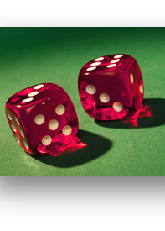
Professional vs. Casual Gambler
Manner
Expertise
Time & effort
Expectation that assets will appreciate
Success in similar or dissimilar activities
History of income & loss
Amount of occasional profits
Financial status
Elements of personal pleasure or recreation

Slide 4
Gambling
Court cases
Professional gambler
Linda Meyers
Trieu M. Le
Casual gambler
Ali Mahammadpour

Slide 5
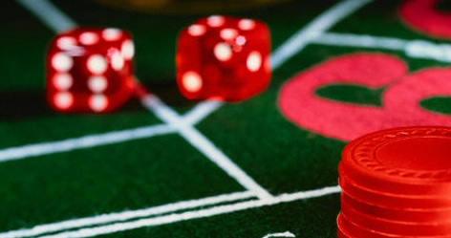
Gambling
Income
Bingo
Lotteries
Card games
Slot machines
Betting

Slide 6
Gambling
W-2G
$600 or more
$1,200 or more from a bingo game or slot machine
$1,500 or more from a keno game
More than $5,000 from a poker tournament
Gambling winnings subject to FITW

Slide 7
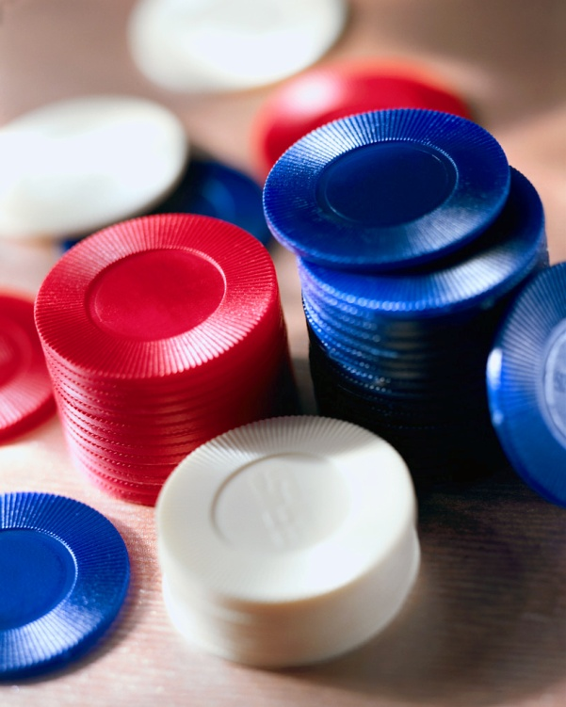
Gambling
Page 83-85
Withholding
24%
Gambling losses
Reporting requirements
Casual gambler
Professional gambler

Slide 8
Gambling
Page 86
Substantiation
Rev. Proc. 77-29
Date and type
Name and location of the gambling establishment
Names of other persons present
Amount won or lost

Slide 9
SAFE HARBOR FOR SLOT PLAY
AM 2008-011
NOTICE 2015-21
ELECTRONICALLY TRACKED SLOT MACHINE PLAY
SINGLE SESSION OF PLAY
REPLACED WITH IRP

