Slide 1
Federal tax law changes
Presented by: Melinda Garvin, ea

Slide 2
Melinda Garvin, EA
Melinda is a tax professional at Foos Garvin Accounting, LLP. in Ohio and has 30+ years of experience serving individual and businesses tax needs.
Melinda has been an instructor for National Association of Tax Professionals (NATP) for over 10 years, has served in the past on the Ohio NATP Chapter Board as the Education Director and is an instructor for Ohio State University. Melinda has also been a presenter at the IRS Nationwide Tax Forums, Ohio State Bar Association, State Chapters of NAEA and local organizations.
Melinda’s instructor specialty is in Ethics and Securing Tax Offices; so, to further encourage tax professionals in office ‘best practices’, she authored the manual “Audit Proof the Tax Office” and has since then published a second manual called “Best Practices for the Tax Office”.

Slide 3
Marked Up 1040

Slide 4
Marked Up 1040

Slide 5
Marked Up 1040

Slide 6
Marked Up 1040

Slide 7
Alimony
After 2018, no longer deductible/includable from or in income
Can modify pre-2019 divorces
Pre-2019 divorces follow old rules

Slide 8
Moving Expenses
No longer deductible
Exception: Armed Forces
Notice 2018-42
18 cents/mile

Slide 9
DPAD – GONE!
But that’s not the rest of the story!
199A is going to impact so many more taxpayers!
We’ll talk about it a little later.

Slide 10
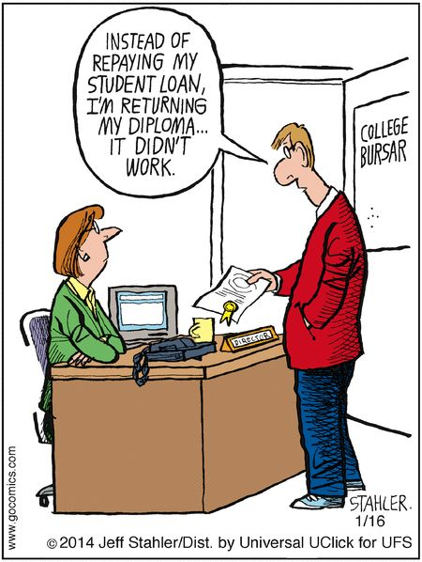
Student Loans Discharged
Excludes debt discharged
Death or
Total and permanent disability

Slide 11
Standard Deductions & Exemptions
Exemptions – Gone
Standard deductions increased
MFJ 24,000
HOH 18,000
MFS/Single 12,000

Slide 12
Dependents
Still important to analyze
Many credits & benefits depend on it
TCJA did not change the definition of a dependent for IRC 152 purposes

Slide 13
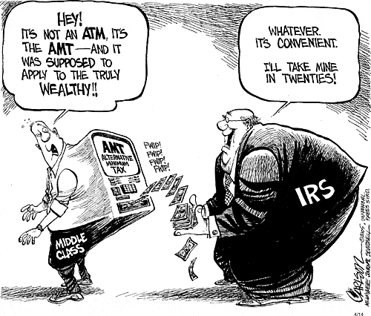
AMT
Not repealed
Exemptions increased
Phase-out of exemption substantially increased

Slide 14
Kiddie Tax
Somewhat simplified
No need to figure parent’s tax rate
However, price paid = taxed at estate & trust rates
Can result in higher taxes

Slide 15
Tax Rates
Taxable Income 2017 Law | Rate | Taxable Income 2018 Law | Rate
Under $9,325 Individual Under $18,650 Married | 10% | Under $9,525 Individual Under $19,500 Married | 10%
$9,325 –$37,950 Individual $18,650 –$75,900 Married | 15% | $9,526 – $38,700 Individual $19,500 – $77,400 Married | 12%
$37,950 – $91,900 Individual $75,900 – $153,100 Married | 25% | $38,701 – $82,500 Individual $77,401 – $165,000 Married | 22%
$91,900 – $191,650 Individual $153,100 – $233,350 Married | 28% | $82,500 – $157,500 Individual $165,001 – $315,000 Married | 24%
$191,650–$416,700 Individual $233,350 – $416,700 Married | 33% | $157,500 – $200,000 Individual $315,001 – $400,000 Married | 32%
$416,700 - $418,400 Individual $416,700 - $470,700 Married | 35% | $200,001 – $500,000 Individual $400,001 – $600,000 Married | 35%
Over $418,400 Individual Over $470,700 Married | 39.6% | Over $500,000 Individual Over $600,001 Married | 37%

Slide 16
Marked Up Schedule A

Slide 17
Marked Up Schedule A

Slide 18
Marked Up Schedule A

Slide 19
Medical
Remains 7.5%
No AMT addback

Slide 20
Taxes
Limited to $10,000 ($5,000 MFS)
Real property taxes
Local property taxes
State/local income tax
Exception
Businesses, rentals

Slide 21
Home Mortgage Interest
Acquisition indebtedness
$1,000,000 for pre-12/16/2017 mortgages
$750,000 for others
No home equity indebtedness
Even if pre-12/16/2017
Watch the definitions!!!!
See examples
Personal Debt
Home Equity
$100K Max
Substantially
Improve
Unpaid
Balance
Original Mortgage
Acquisition Debt
Unpaid Balance
Acquisition Debt

Slide 22
Charity
Mostly intact
Now 60% AGI limit
No deduction if receipt of right for tickets or seating at athletic events

Slide 23
Casualty Losses
Personal = federally declared disasters only!
No deduction for theft, fire, etc.
Business = still allowed

Slide 24
2% Itemized Deductions - GONE

Slide 25
Gambling
Pre-TCJA losses allowed per Code Sec 165d
TCJA expanded definition of term losses

Slide 26
Child Tax Credit

Slide 27
CHILD TAX CREDIT
Child Tax Credit Phase-out Threshold Comparison
Filing Status | 2017-pre TCJA | 2018 per TCJA
MFJ | $110,000 | $400,000
S, HOH | $75,000 | $200,000
MFS | $55,000
The new child tax credit is $2,000, with up to $1,400 being refundable.

Slide 28
OTHER DEPENDENT CREDIT
$500
Non Refundable
ATIN or ITIN will Qualify

Slide 29
A couple of tcja changes
Shared responsibility payment
Penalty
Not gone – it’s just zero for 2019
Still here for the 2018 returns
529 plans
Distributions up to $10K per bene can be used for tuition (broad description)
Able accounts too!

Slide 30
Head of Household - Parents

Slide 31
Head of Household
New penalties!!!
$520
Form 8867 will be updated
Remember the rules
Unmarried
Half the cost
Qualifying person

Slide 33
Costs

Slide 34
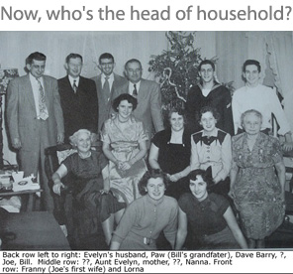
Head of Household – See Examples
Child who qualifies
Child who doesn’t qualify
Girlfriend with no child together
Girlfriend with child together

Slide 35
Estate & Gifts
Not repealed
Doubled the exclusion amount
Step-up retained

